Slide 1
Advance Java
Servlet Filtering
LEVEL – PRACTITIONER

Slide 2
About the Author
Created By: | Renjith(t-renjith)/ Shanmu (105110)
Credential Information: | Trainer / Sr Architect
Version and Date: | 1.0, January 5’th 2012
Cognizant Certified Official Curriculum
Notes:
For tde animators:
tdis screen content needs to be rendered in tde flash, no animations needed.

Slide 3









Icons Used
Hands on Exercise
Questions
Tools
Coding Standards
Test Your Understanding
Case Study
Best Practices & Industry Standards
Demonstration
Workshop

Slide 4
Objectives
After completing this chapter you will be able to understand:
What are servlet filters?
Need for Filtering.
How to do Filtering.

Slide 5
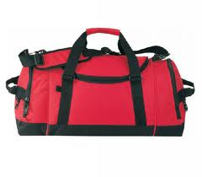




What happens in a Airport?
Before passengers board a flight how will the flight management ensure that the passengers are not bringing in harmful objects.
Scanners
You are right they use scanners to scan the luggage's of passengers before they board the flight and discard the ones with harmful items

Slide 6
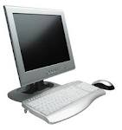
What is a servlet Filter?
Servlet filter are programs (like the airport scanners) that runs on the server which intercepts HTTP request/response for transformations/processing/filtering.
A filter program used for transforming/ filtering HTTP request or transforming HTTP response.
WEBSERVER
Request intercepted by filters transformed/processed.
Client requests for employee details
Filter
Employee Servlet
Client
Filter
Transformed response sent to client
Response from employee servlet is intercepted by filter and transformed.

Slide 7
How does Filter work?
Sequence of operation of a servlet filter,
Step 1: Intercepts the client HTTP request and pre process the request.
Step 2: Invokes the requested resource with the pre-processed HTTP request.
Step 3: Intercepts the HTTP response and transforms it.
Step 4: The transformed HTTP response will be sent back to the client.

Slide 8
Usage of Filters.
Used for authenticating all HTTP request coming to the server.
Example: All requests to the application will be authenticated and authorized against stored user credentials.
All the HTTP requests can be logged and audited in a flat file or database for tracking users of a web application.
Example: The user credentials can be logged as “Ron logged in at 8:00 PM and he transferred 10,000 dollars from the account”
To perform some formatting of HTTP response, say display a message in the header (or) bread crumbs for all the pages of the application.
Example: All the HTML pages displayed in the client should have the navigation breadcrumb like “Home Page> Savings Account>Account Summary”

Slide 9
Important Filter Interfaces
Filter : Contains the methods for filtering the request/response
FilterChain : Contains the methods for chaining the Filters
FilterConfig : A filter configuration object used by a servlet container to pass information to a filter during initialization. Contains the methods for accessing the filter initialization parameters and getting the servlet context in which the filter runs.

Slide 10
Steps to create a filter.
Step 1 : Create a class that implements the Filter interface.
Step 2 : Implement the doFilter method with the pre/post processing logic.
Step 3 : Invoke the doFilter method of the FilterChain object.
Step 4 : Register the filter with the appropriate servlets.

Slide 11
Step 1 : Creating the Filter Class
All filters must implement javax.servlet.Filter.
This interface comprises three methods which needs to be overridden and implemented,
doFilter()
init()
destroy()

Slide 12
What is doFilter method?
Syntax:
public void doFilter(ServletRequest request,ServletResponse response,FilterChain chain) throws ServletException, IOException
This method is executed every time when a servlet (or) jsp associated with this filter is invoked.
This contains the filtering/pre & post processing logic.
Method Arguments:
ServletRequest : Request object of the incoming request to be intercepted and processed.
ServletResponse : Response object of the outgoing response to be intercepted and processed.
FilterChain : The filter chain object on which the doFilter method of the FilterChain interface can be called.

Slide 13
Filter Chain interface
Multiple filters can be chained and invoked one by one this is achieved using the FilterChain interface.
Filters use the FilterChain to invoke the next filter in the chain (or) if the calling filter is the last filter in the chain It will invoke the resource at the end of the chain.
FilterChain contains only one method,
void doFilter(ServletRequest request, ServletResponse response)

Slide 14
Override Filter Init method
Syntax:
public void init(FilterConfig config)throws ServletException
Executed only when the filter is first initialized. It is not executed each time the filter is invoked.
It is used for initializing parameters to be used by filters.
Can be used to reference and read parameters from ServletContext using the FilterConfig object
Can be used to read the filter initialization parameters that are declared in the web.xml file.

Slide 15
What is Destroy method?
Syntax:
public void destroy()
This method is invoked when the servlet life cycle is completed typically when the server is shut down.
Can be overridden and used for cleanup tasks like closing files or database connection pools that are used by the filter.

Slide 16
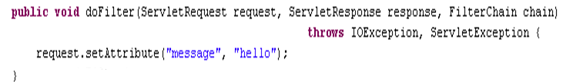
Step 2 : Override the doFilter Method
Override the doFilter method to perform one or more of the following tasks,
Transform the incoming request.
Transform the response before being sent to the client.
Invoke the doFilter method of the FilterChain interface
Example: The filter method is overridden to set a message parameter with value “Hello” in all the HTTP request.

Slide 17

Step 3 : Invoke the doFilter Method of the FilterChain
The doFilter method of the FilterChain object as argument to the doFilter method of Filter interface should be invoked.
Invoking this method can invoke all the filters in the chain and finally the servlet or jsp.

Slide 18
Step 4 : Register the Filter
The filters needs to be registered with appropriate servlets in the web.xml file.
Web.xml uses two elements for declaring filters,
filter : Registers a filtering object with the system.
filter-mapping : Specifies the URLs to which the filtering object applies.

Slide 19
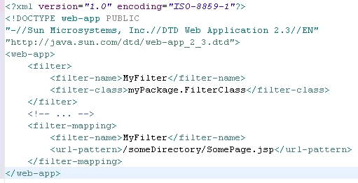
Sample Web.xml with Filter Configured
Name: Represents the name of the filter.
Class: Represents the fully classified filter class name.
Represents the URL patterns for which the filter will be invoked.
NOTE: URL patterns can be a specific Servlet/JSP (or) a URL with wild card character.
Example: /savingsAccount/* - This means filter will be triggered for all the components requested under the savings Folder.

Slide 20
Lend a Hand Exercise # 1- Intercepting Request using Filter
In this demo we will create a Filter which is capable of intercepting the HTTP request and setting an attribute in the request each time a Servlet is invoked.
Components:
Filter Demo Servlet - Servlet whose request to be intercepted and filtered.
First Filter – Filter to intercept the request and setting the attribute.

Slide 21
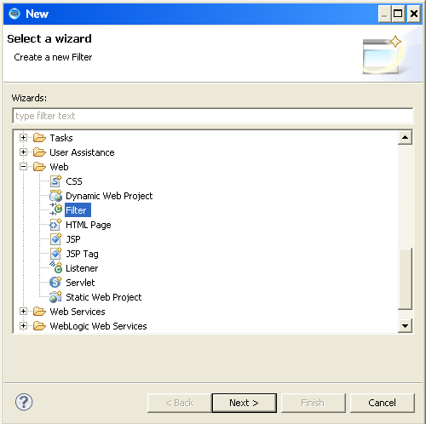
Lend a Hand - Step 1 : Create a filter
Create a dynamic web project in eclipse.
Right Click src folder →click new→click other→click web→click Filter

Slide 22
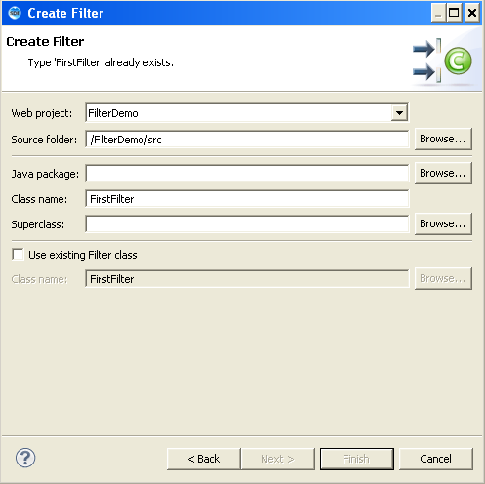
Lend a Hand - Step 1 : Create a filter (Cont)
Specify the Filter class name

Slide 23
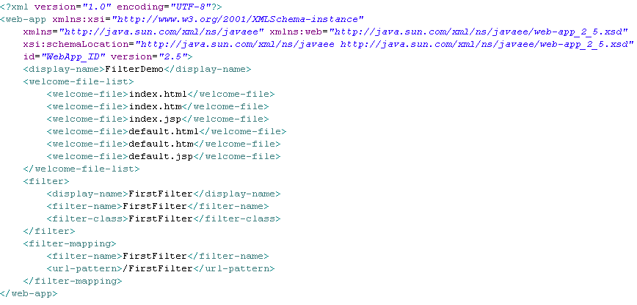
Lend a Hand - Filter Configuration in in web.xml
Verify the web.xml for the filter configuration.
Filter declaration
Filter Mapping

Slide 24
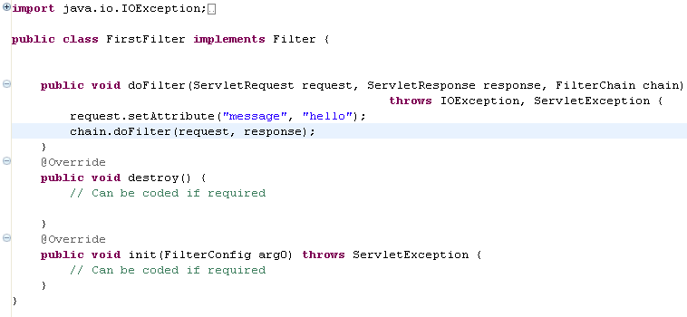
Lend a Hand - Step 2 & 3 implement the doFilter Method
Implement the filter as mentioned below. Set the attribute in the request parameter and invoke the doFilter() of the FilterChain.
Implements Filter interface.
doFilter method invoked.

Slide 25
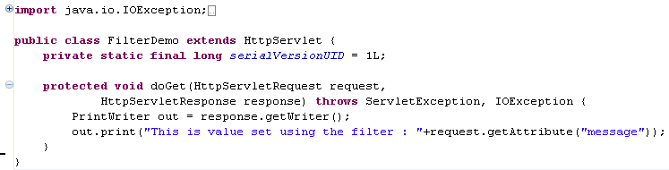
Lend a Hand- Create the Servlet FilterDemo
Implement the servlet as mentioned below. Servlet will access the attribute set in the filter.
Servlet accessing the attribute set in the filter.

Slide 26
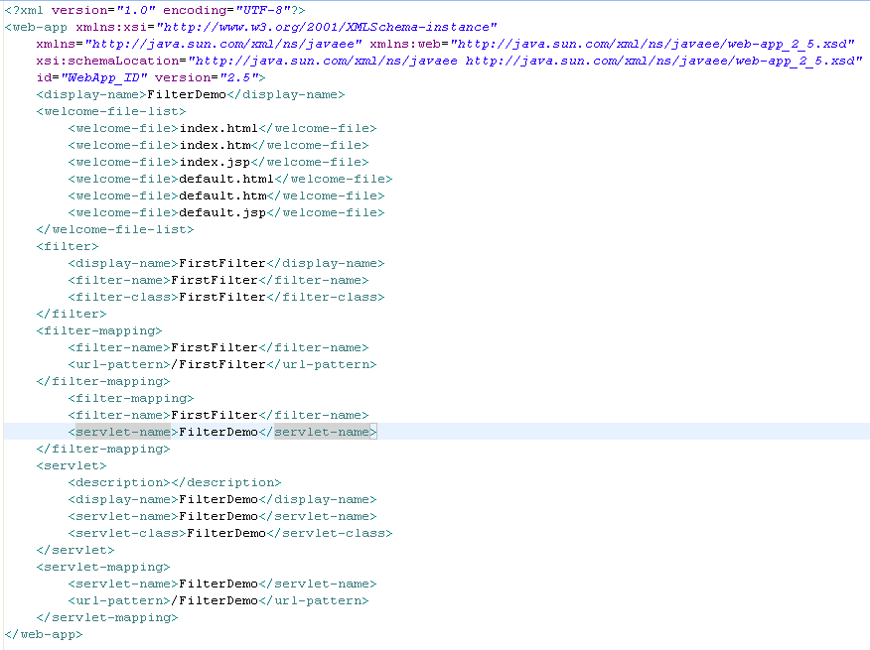
Lend a hand - Step 4 :Configure the Filter for the Servlet
The filter can applied for the servlet by adding a filter mapping for the servlet in the web.xml file.
Configure the servlet with the filter.

Slide 27
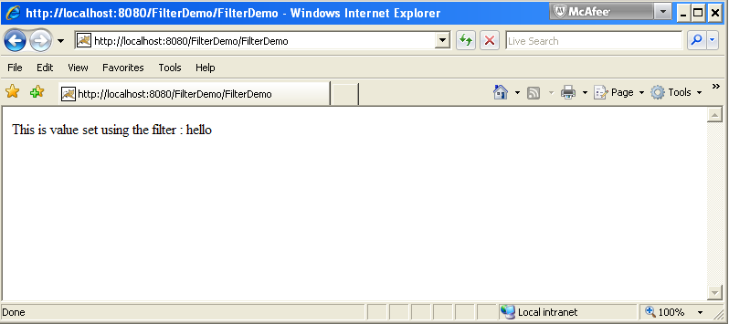
Lend a hand - Deploy and Run
Step 1 : Deploy the application and run the application
Step 2 : Invoke FilterDemo from browser
http://localhost:8080/FilterDemo/FilterDemo
In the example the request to the servlet “FilterDemo” is intercepted by the filter and the message “Hello” set in the filter is displayed in the servlet.

Slide 28
Lend a Hand Exercise # 2 – Filtering the Response
In this demo we will se how the response can be modified by using filters .
Response object can be modified in the filter before it is sent back to the client.
Components :
ReponseFilter : - The filter responsible for filtering the response
SourceServlet :- The servlet which the user requested.

Slide 29
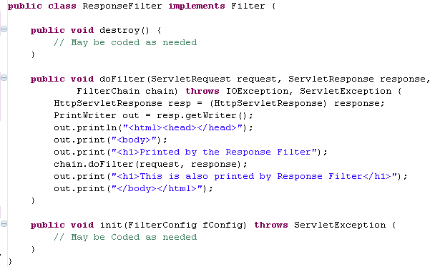
Lend a Hand : Develop the Response Filter
Develop the filter as shown below.
Response object is type casted to HTTPTServletResponse and header messages set.

Slide 30
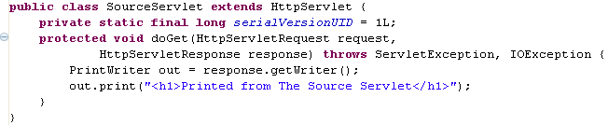
Lend a Hand : Develop the Source Servlet
Develop the servlet as shown below.

Slide 31


Lend a Hand : Web.xml
Step 1 : Verify the filter entry in the web.xml file (Will be automatically added when ResponseFilter is created)
Step 2 :Add the following filter mapping into the web.xml file

Slide 32
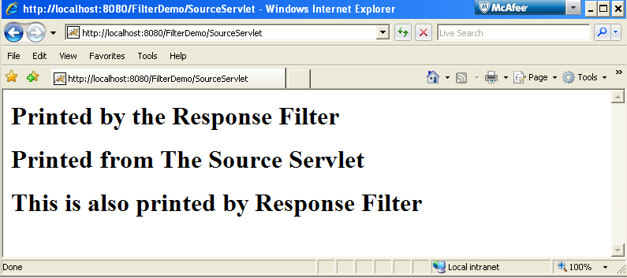
Lend a Hand – Deploy and Run
Step 1 : Deploy and run the application
Step 2 : Invoke SourceServlet from the browser.
http://localhost:8080/FilterDemo/SourceServlet
Printed by the filters.
Printed by the servlet.

Slide 33
What is Filter Chaining?
Filter chaining is the process of applying more than one filter to a Servlet.
Assume there are two filters Filter A & B , they can be configured as below. The request goes through both the filters before it reaches the servlet.
Filter A
Filter B
Servlet

Slide 34
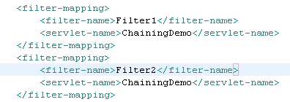
How Filter Chaining Configured?
This is done by configuring more than one filter mapping for a servlet in the web.xml file
The filters are invoked in the order they are declared in the web.xml file
Filter1 & Filter2 configured with the ChainingDemo servlet

Slide 35
Lend a Hand – Filter Chaining
This is a demo for the associates to get familiarized with how more than one filter can be applied to a single servlet by the process of filter chaining.
Components
Filter1 : Filter class
Filter2 : Filter class
ChainingDemo : The servlet for which filtering needs to be done.

Slide 36
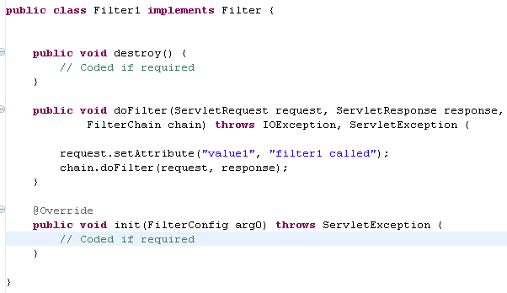
Lend a Hand : Develop First Filter
Create a filter which adds an attribute to the request object.
Set a parameter in filter

Slide 37
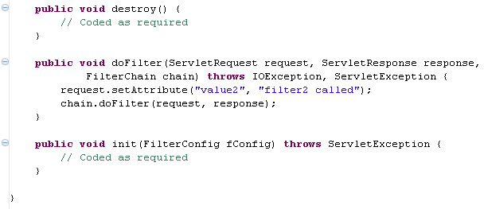
Lend a Hand : Develop the second Filter
Create the second filter “Filter2” which adds an attribute to the request object.
Set a parameter in filter

Slide 38
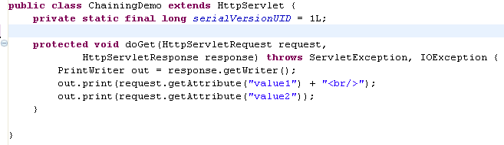
Lend a Hand : Develop the servlet
Create a Servlet called ChainingDemo
Display the values set in both the filter.

Slide 39
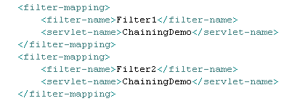
Lend a Hand : Configuring filters in Web.xml
Add the following filter mapping to the web.xml file.

Slide 40
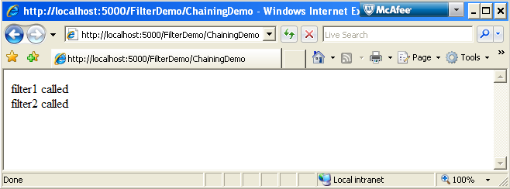
Lend a Hand : Deploy and Run
Step 1 : Deploy the application and Run the application
Step 2 : Invoke ChainingDemo Servlet from the browser.
http://localhost:5000/FilterDemo/ChainingDemo
The messages set in both the filters can be accessed and displayed in the servlet.

Slide 41
Few Information About Filters
A filter can be used for filtering more than one servlet, by configuring the same filter with multiple servlets.
More than one filter can applied to a single servlet, applying two filters with a servlet called servlet chaining.
The following are some instances where filter are used on application development,
Authentication/Authorization of all HTTP request to web applications to ensure that authorized user access we application.
To pre/post process request like checking message format, validating form data etc.

Slide 42
SERVLETS
You have successfully completed –
Servlet Filters

